Slide 1
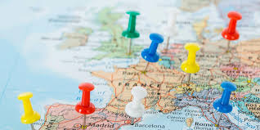
The Traveller Bot
Group Members:
Pooja Mishra (17IT1082)
Neha Singh (17IT2012)
PROJECT GUIDE:
Anita Patil Mhatre

Slide 2
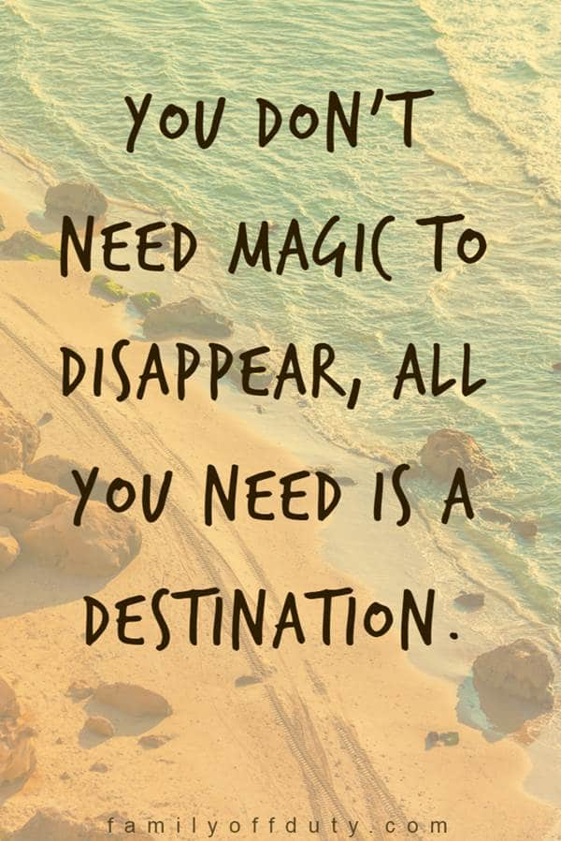
INTRODUCTION
Today in this busy schedule we barely have the energy to look out for oneself. And yet when we plan to make a relaxing trip we ending up taking more pressure thinking where to go ! With people having not so much idea about places they miss the opportunity to see the world closely and enjoy themselves.
To help you relax completely we hereby present you your Personal Travel Assistant.

Slide 3
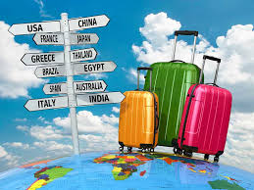
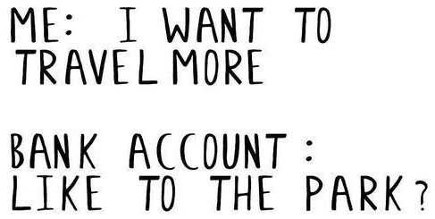
PROBLEM STATEMENT:
To avoid tension of planning any event to get relaxed with friends or family.
To help you pick up a location quickly according to your Occasion, Type, feasibility and Taste.
To waste less of our time in planning and more time in enjoying oneself.

Slide 4
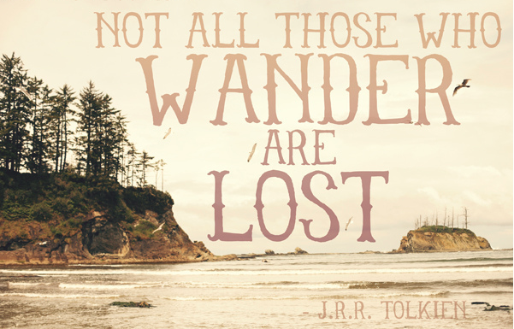
Why ASSISTANT?
Keeping you connected to the world.
Learning is a strong reason why people love to travel. They want to experience something unfamiliar and leave with new skills or knowledge. And being assisted will save your time and money and help you achieve a great experience.

Slide 5
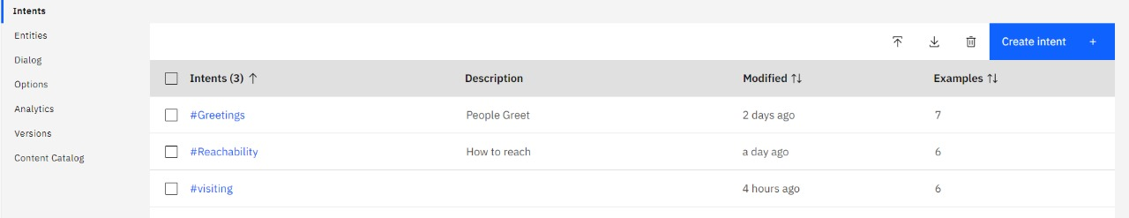
METHODOLOGY:
INTENTS

Slide 6
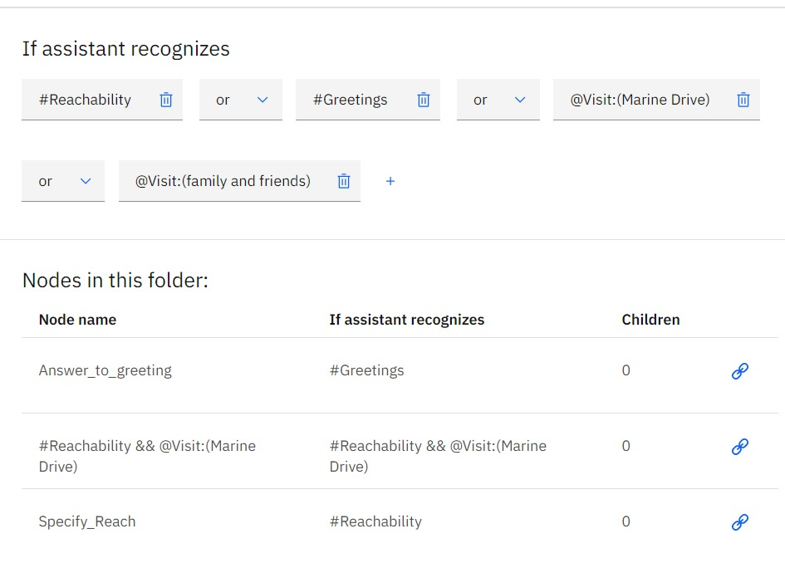
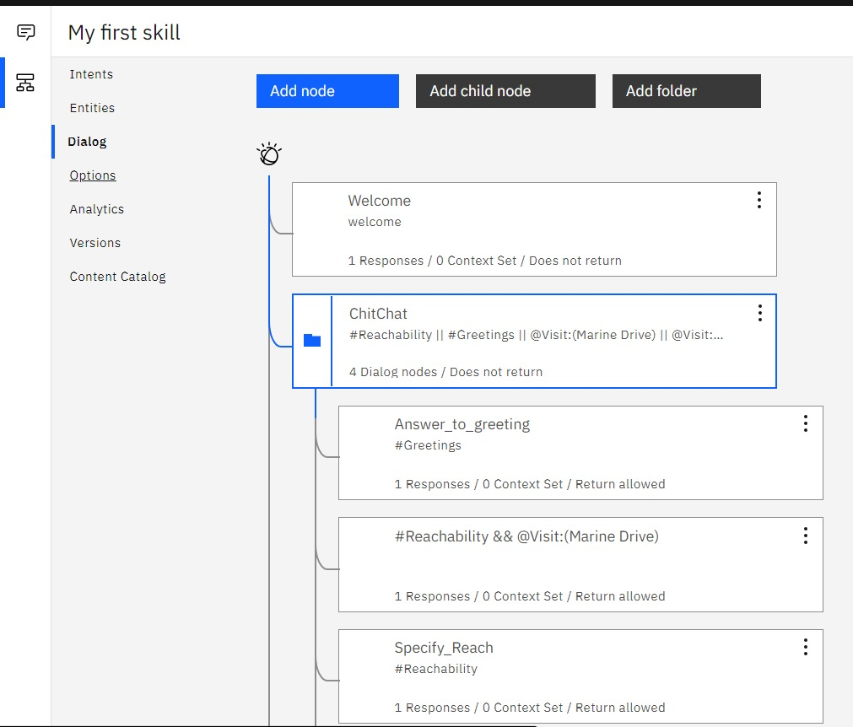
DAILOGUE FLOW
DAILOGUE FLOW

Slide 7
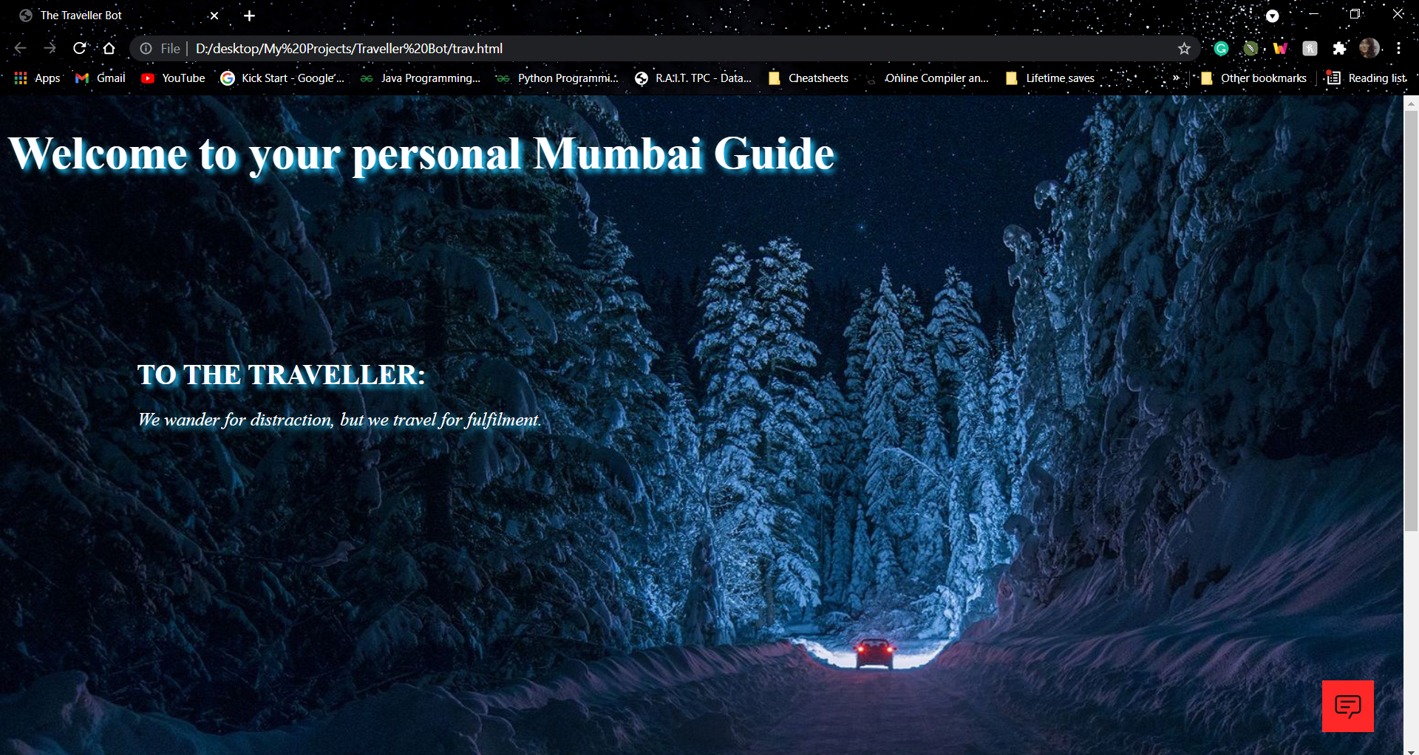
IMPLEMENTATION:

Slide 8
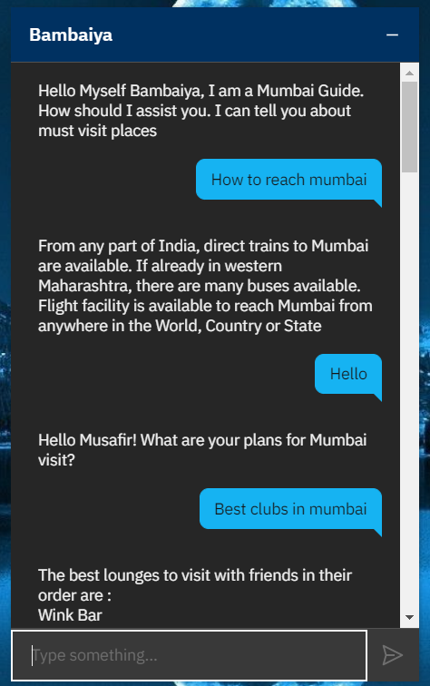
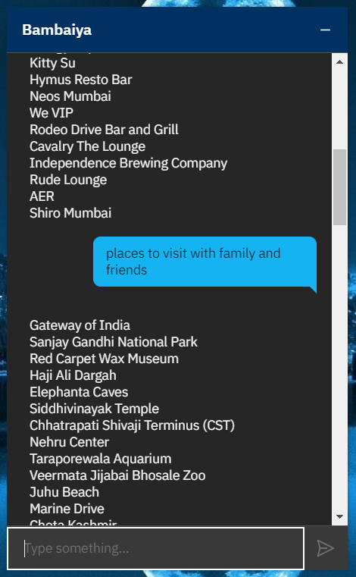
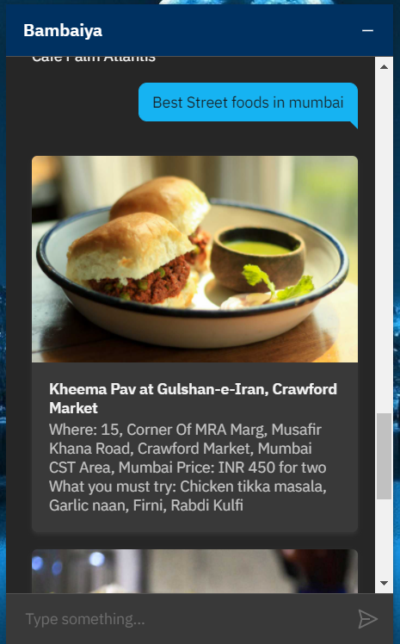

Slide 9
Thank you

